Slide 1
Biweekly Update
March 6, 2023
The Little Engineers that Could: Blake, Sam, Melanie, and Amy

Slide 2
Ordering Parts
Barrel
Added threading for die; adjusted length of barrel
Talked to Hamilton Machine Shop, waiting for quote
Have soft barrel as well from McMaster Carr if it is not a good quote
Next group will be remaking barrel if they continue, may be fine to not have long lasting barrel
Housing
Test design → ready for Send Cut Send
Other Components
Have them ready to order from McMaster Carr

Slide 3
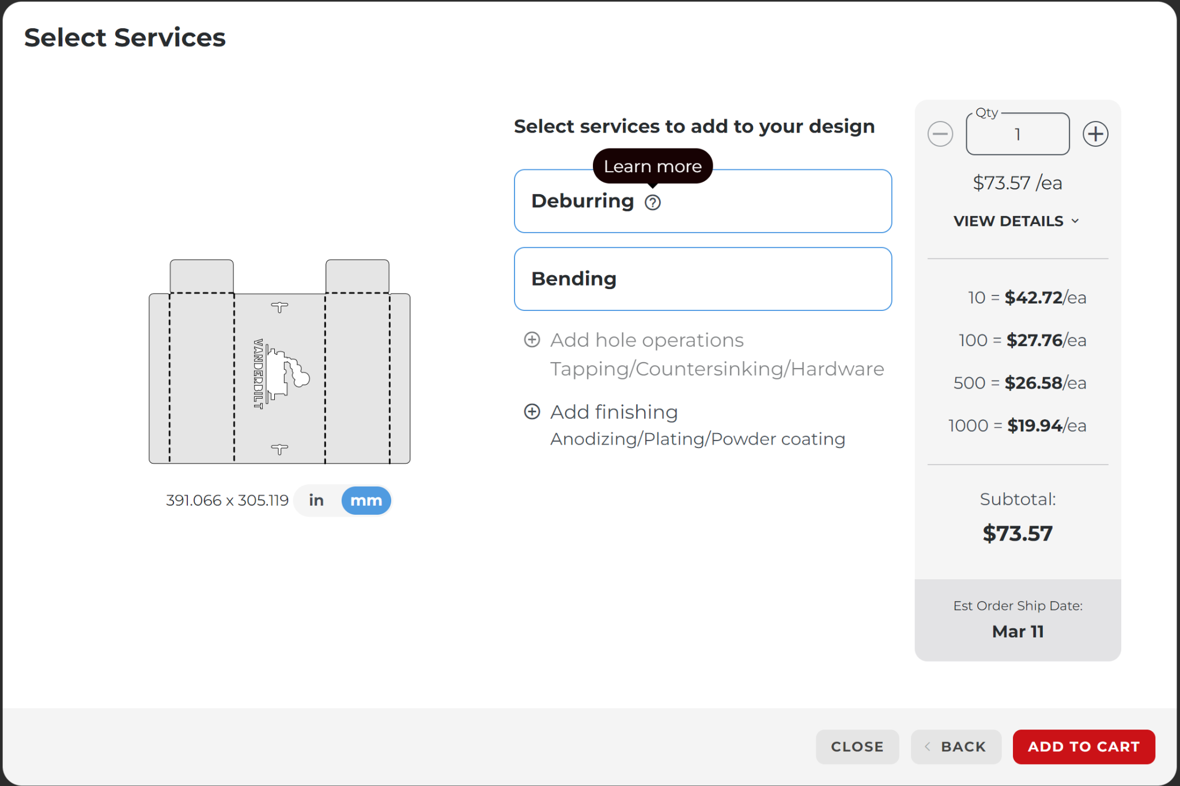
Test “Housing” from SendCutSend

Slide 4
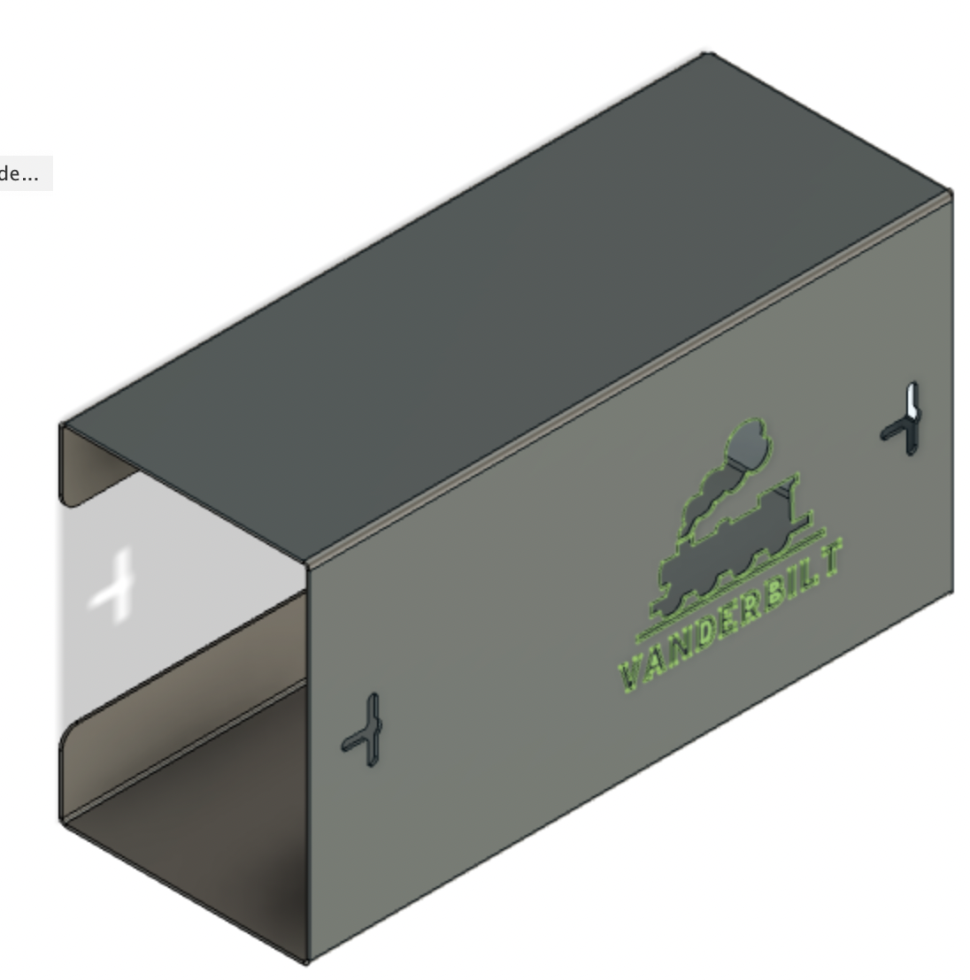
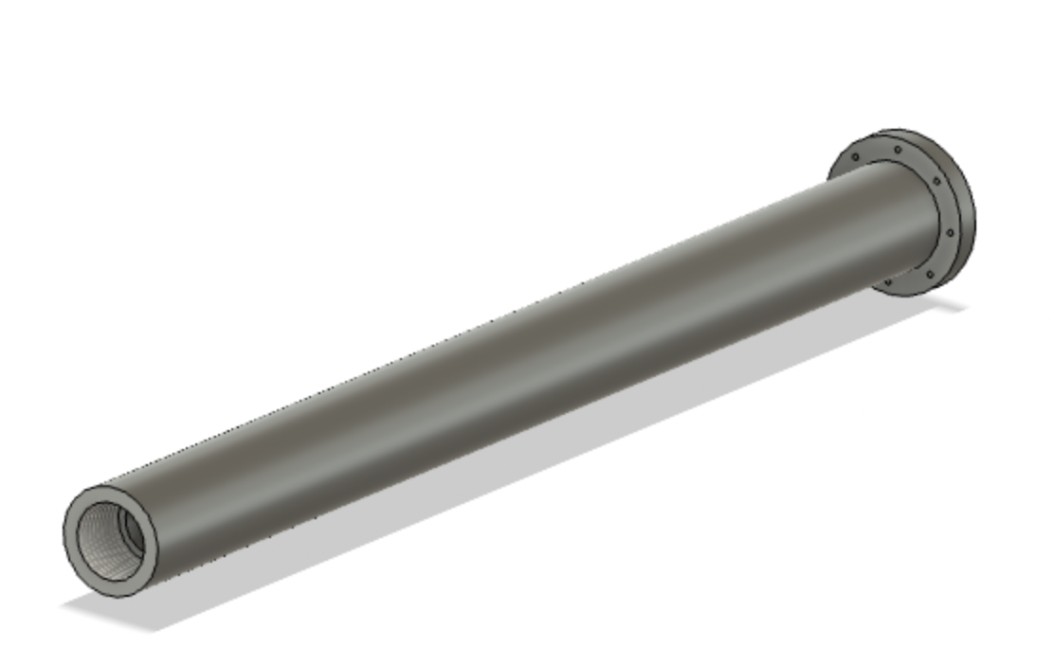
CAD Modeling
Notes:
Notes for this Slide:
Made initial drawing of assembly of components, what parts we need to design (top left)
Bottom left, flanged portion that will need to be welded to barrel to attach to the part on the bottom right
Bottom right, coupler between barrel and hopper, has exposed section for where the pellets can be fed into the screw
David can fabricate the bottom left and bottom right parts, need to still design parts for connecting screw components to the gearbox

Slide 5
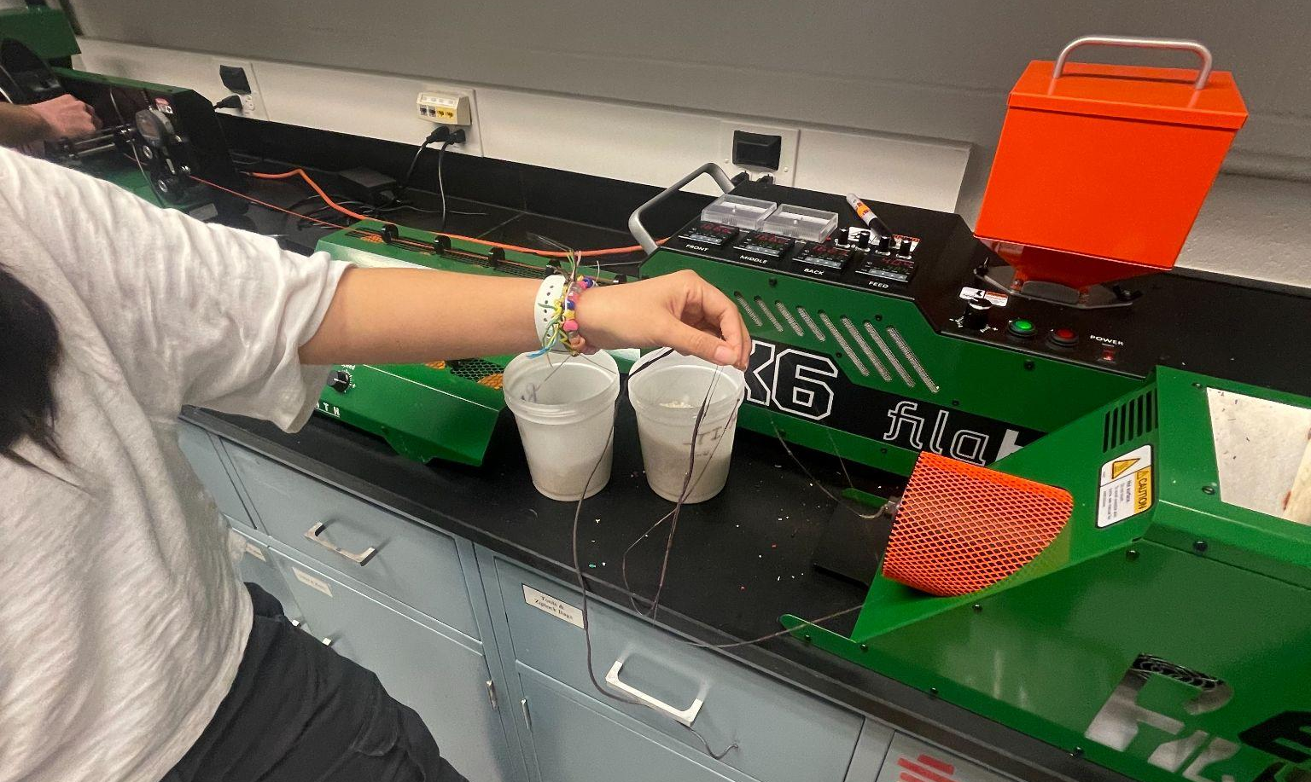
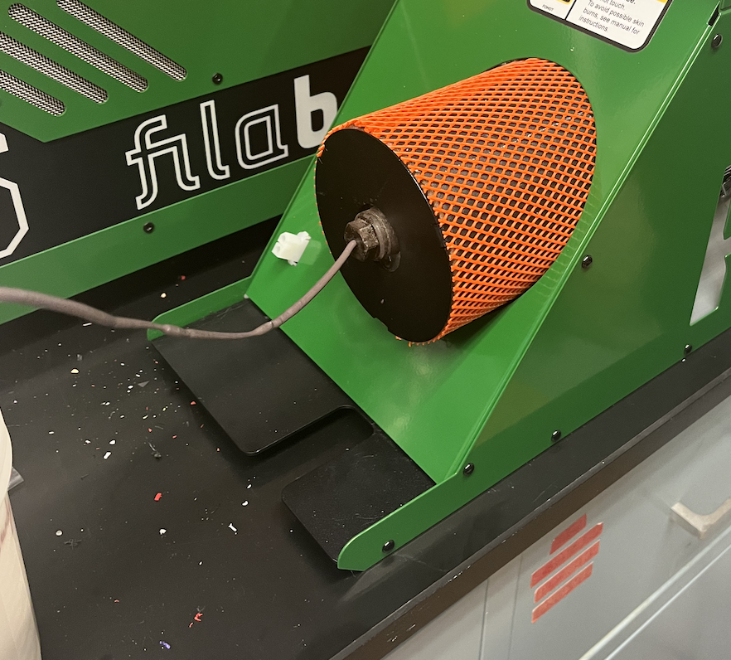
Regrind EX2 Concept Test
Successfully made rough filament from the regrind with the EX2
Going to make more filament going forward
Then going to pelletize the filament to create recycled pellets
Test apple peeler once it arrives from EBay

Slide 6
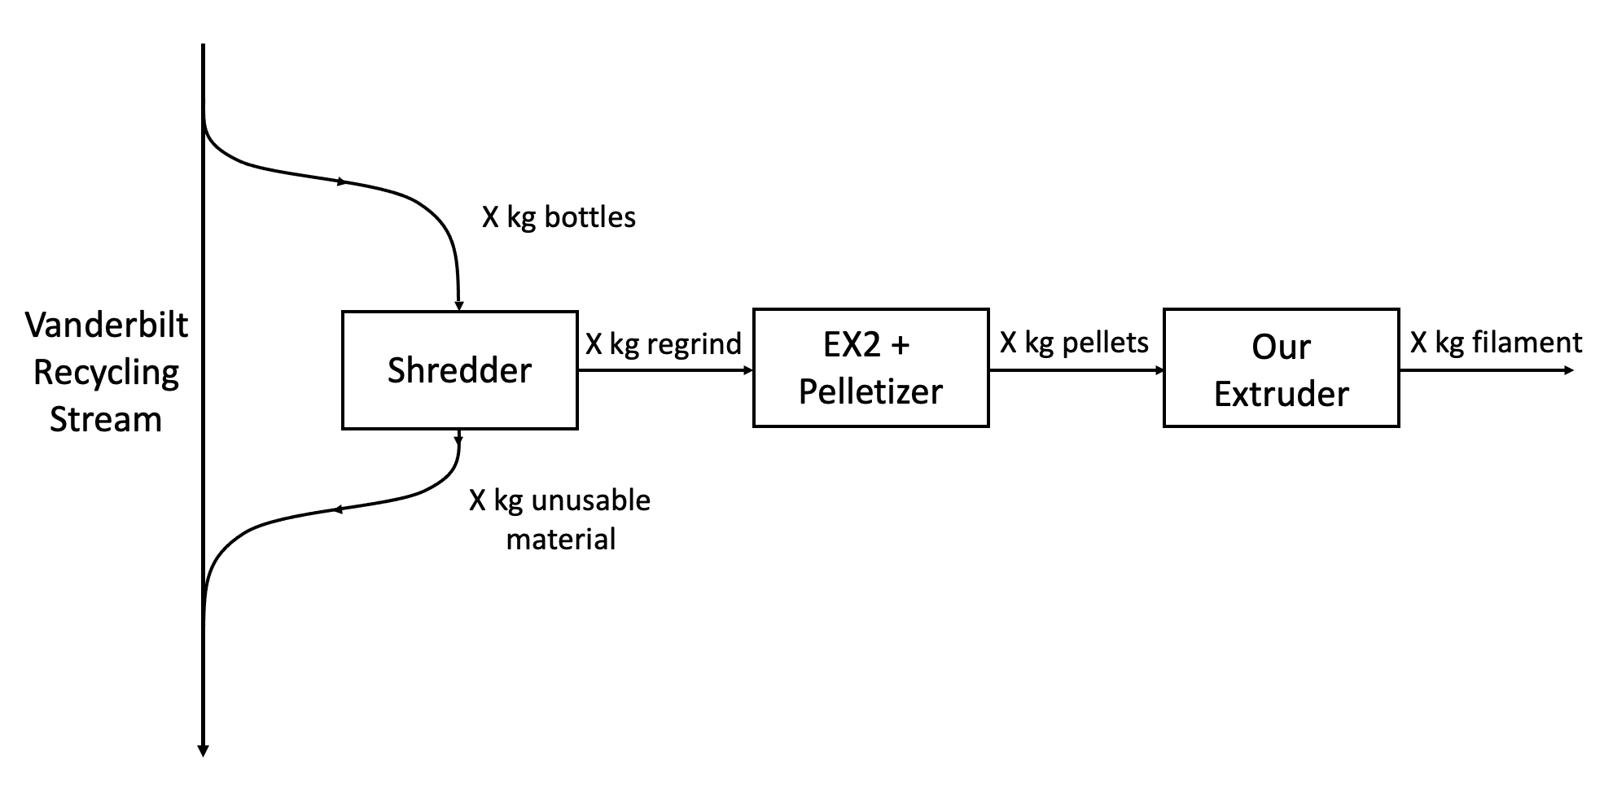
Initial Process Flow Diagram

Slide 7
Process Description
We are operating a slip stream from Vanderbilt’s primary recycled plastic stream with the goal of turning PET bottles into usable 3D printing filament. The process starts with receiving PET bottles from Vanderbilt Recycling. These bottles are then sorted by production origin (e.g. Coca-Cola bottles vs PepsiCo bottles) and shredded into rPET regrind. Thicker portions of the bottle, such as the curved bottoms and tops, and the bottle caps cannot be shredded; these are reintroduced to Vanderbilt’s plastics stream. The rPET regrind is then extruded through an Filabot EX2 to create filament that is then pelletized. These pellets are then fed into the student-built PET extruder creating our final product: Vanderbilt-sourced rPET filament.

Slide 8
Bottle Efficiency
Need to determine the efficiency of each type of bottle
For example, how much does a particular coke bottle weight? How much recyclable content can we get from each type of bottle
Once we determine the efficiency of each bottle type, we can create a rough estimate of how much of Vanderbilt’s waste stream can actually be recycled by us

Slide 9
Action Items/Questions
Finish Nextrucad simulations
See February 6 meeting notes
Order electronics from McMaster Carr
Finish book form - we need to figure out what image to include
Design and order hopper
What material should we make our housing out of?
What material should we make our hopper out of (can we 3D print it)?
Will our test sheet metal order be worthwhile?

Slide 10
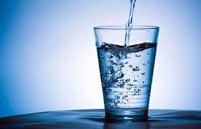
“Just keep swimming”
Michael Phelps

